Slide 1
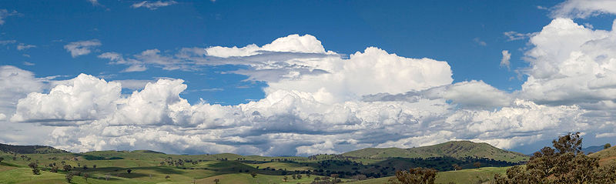
INGI2145: CLOUD COMPUTING (Fall 2014)
Introduction
18 September 2014
Lecture slides adapted from Upenn NETS212 by A. Haeberlen, Z. Ives Reproduced with permission

Slide 2
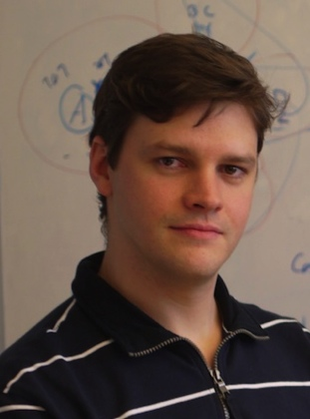
Welcome!
My name: Marco Canini
Faculty member at INGI
Research interests:
Software-Defined, Reliable Networked Systems
Cloud Computing
See also: http://perso.uclouvain.be/marco.canini/

Slide 3
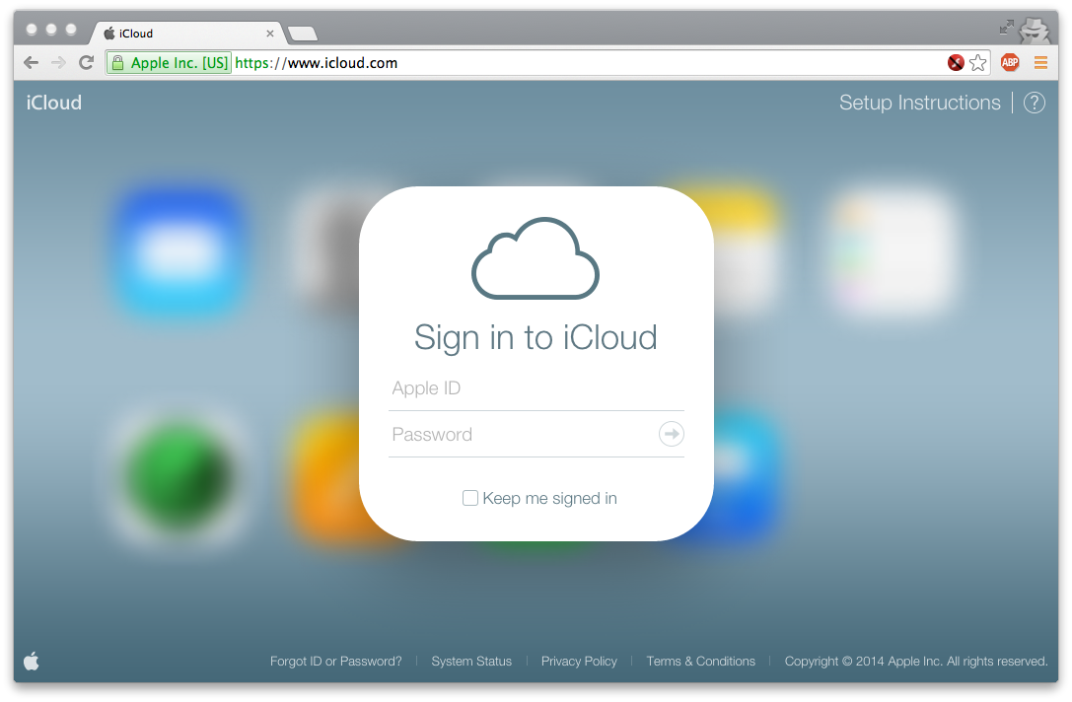
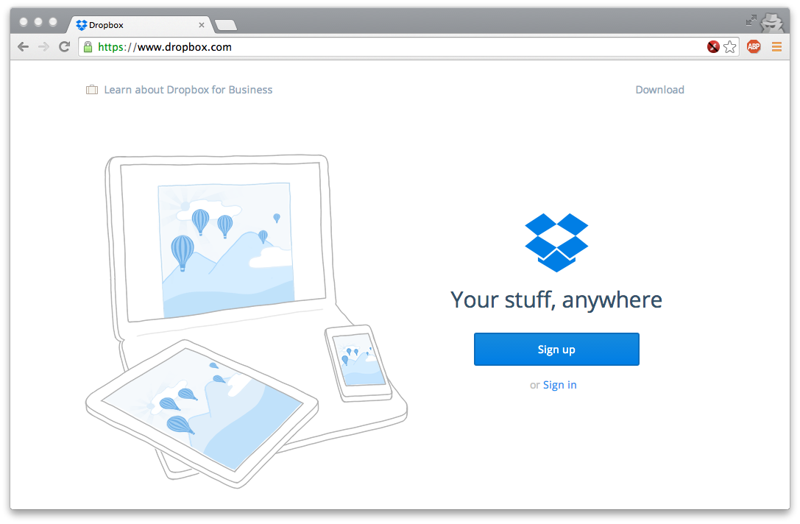
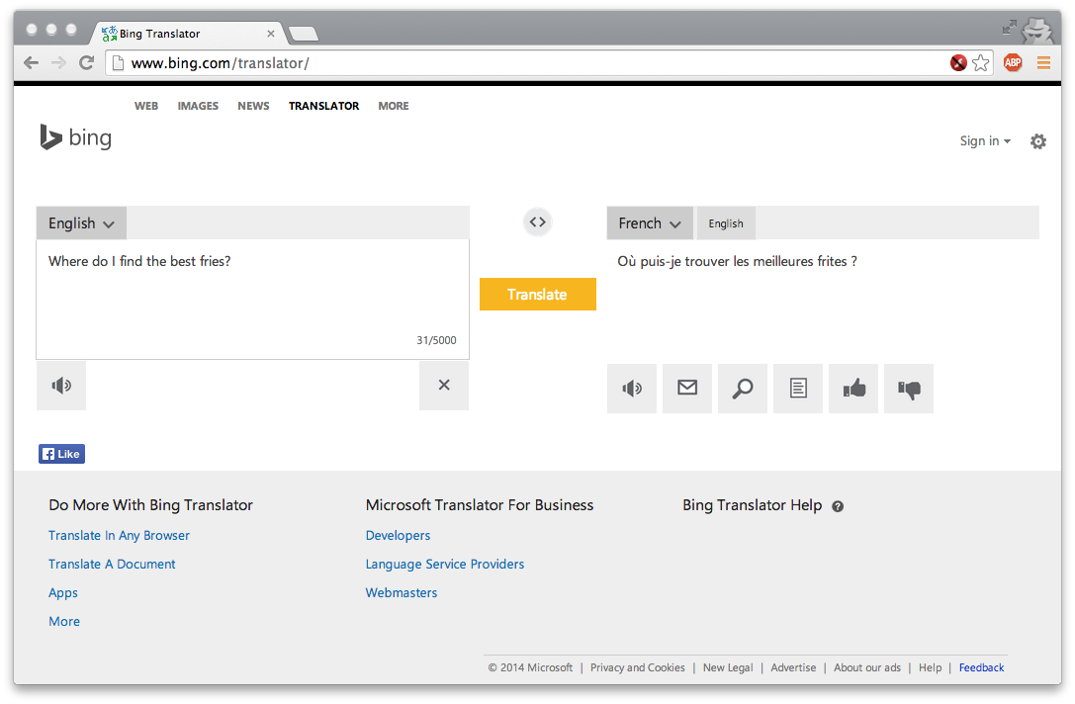
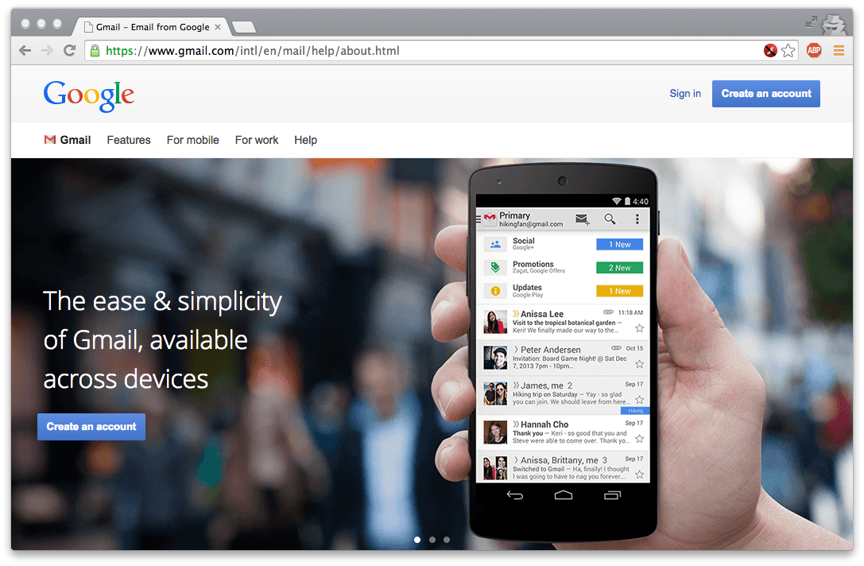
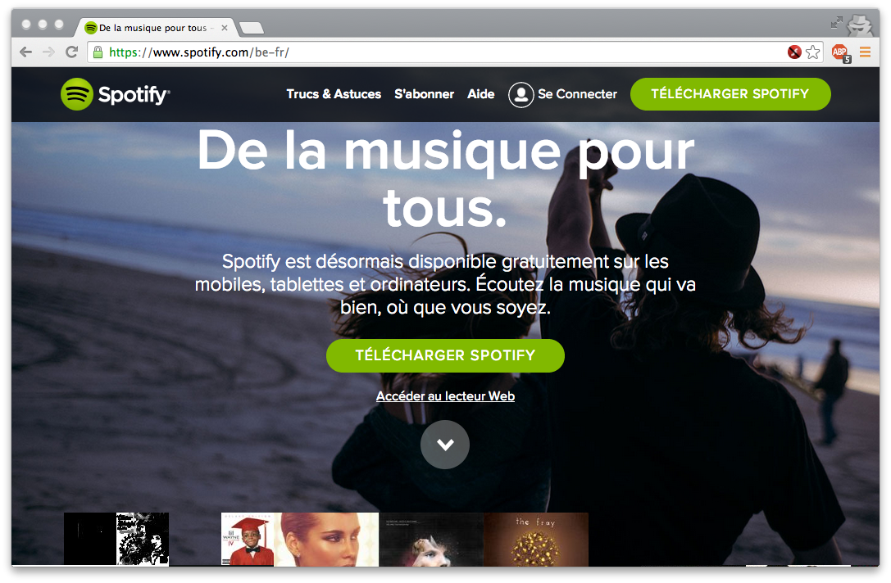
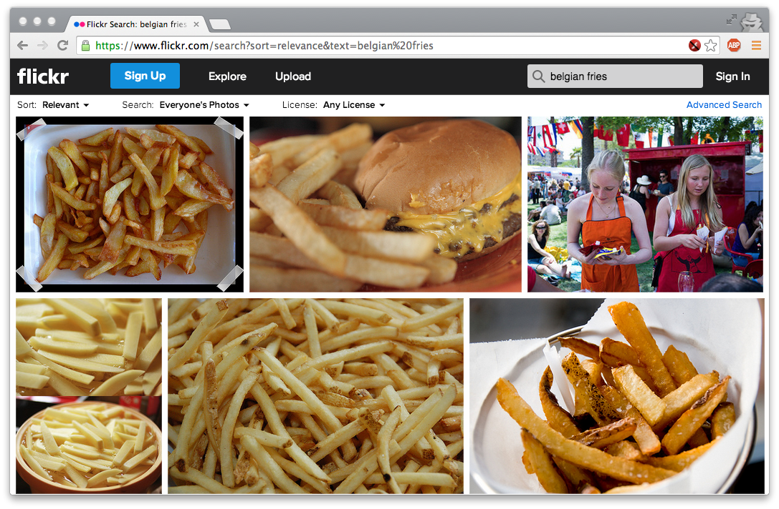
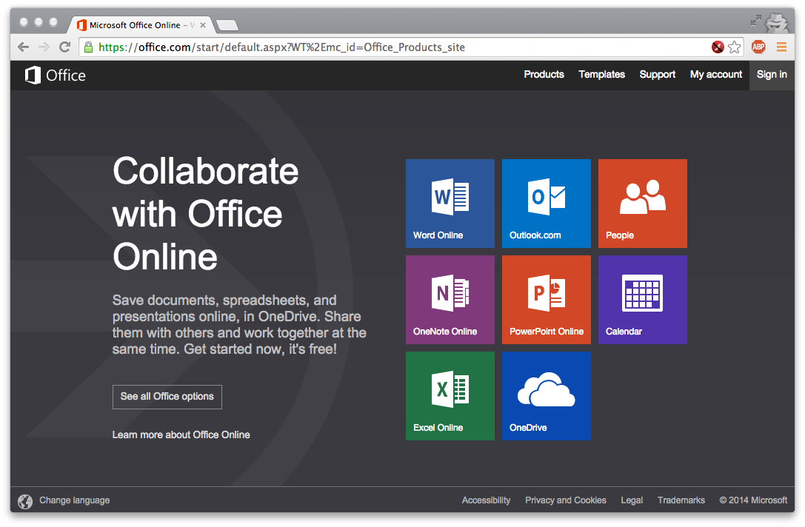
Have you used 'the cloud' before?

Slide 4
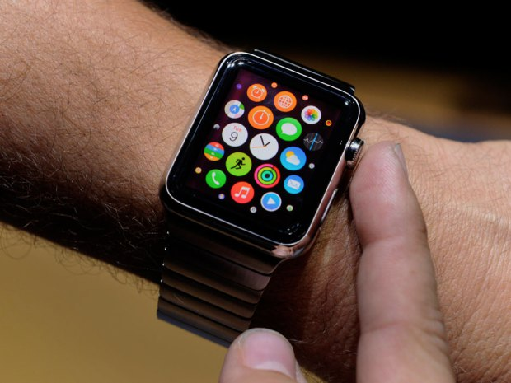
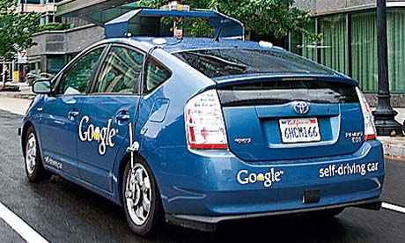
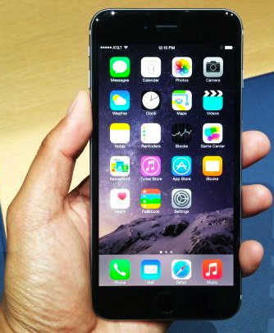
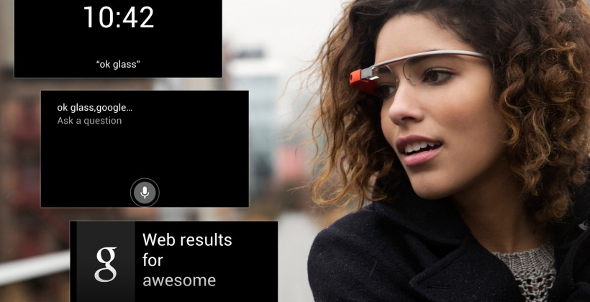
The cloud in your pocket and beyond
Notes:
http://static.guim.co.uk/sys-images/Guardian/Pix/pictures/2013/4/10/1365602225561/Self-driving-car-008.jpg
http://wpmedia.business.financialpost.com/2014/09/apple-watch-features-apps.jpg?w=620
http://cdn.slashgear.com/wp-content/uploads/2013/02/google_glass_ui_leak_hero-820x420.jpg
http://oyster.ignimgs.com/wordpress/stg.ign.com/2014/09/0909141210a_1-720x405.jpg

Slide 5
Why should I care?
Understand what’s underneath the Cloud
How does it work? What are its strengths? Its shortcomings?
Technologies: virtualization, MapReduce, key-value store, NoSQL, Ajax, ...
Understand the underlying principles
How do you build something that is so scalable, robust, etc.?
Lots of clever algorithms needed - very different environment!
Be able to use the right approach when designing new protocols and web systems
How would you go about building the next Facebook?
Need to scale, be efficient, avoid failures, prevent intrusions, ...

Slide 6
Why should I care? (continued)
Gain practical experience with cloud technologies
Often, the best way to understand it is to build one yourself
In this course, you will build on top of Amazon Web Services and Apache Hadoop
Understand the impact on society
Vulnerabilities, privacy concerns, data survivability, ...
Need to understand the current state of the technology!
Anticipate what’s possible in the future

Slide 7
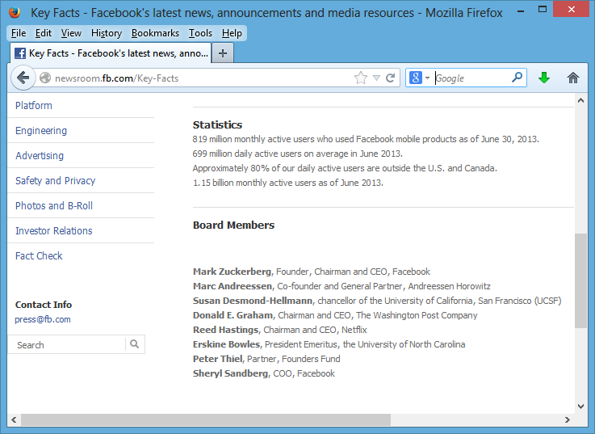
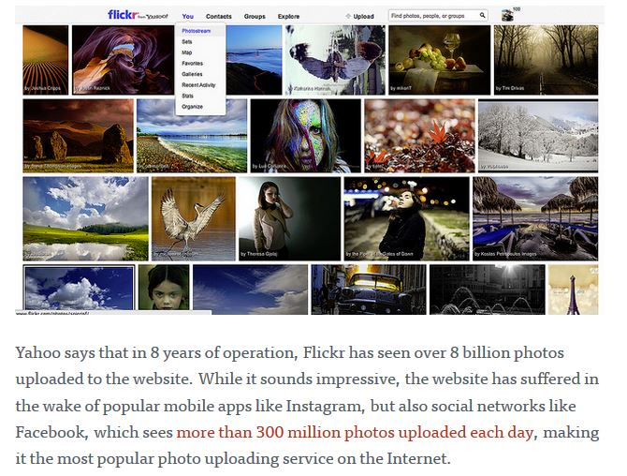
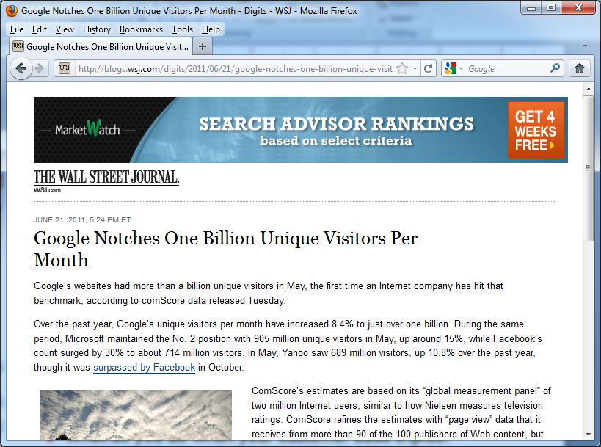
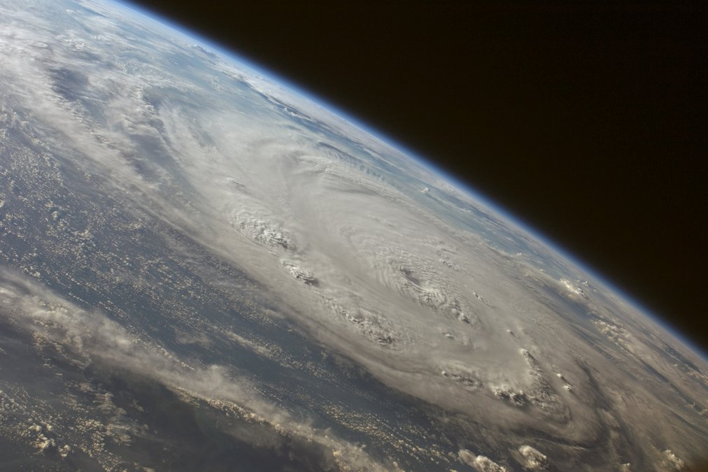
How big is the cloud?

Slide 8
Data-centric computing
Trend towards data-centric computing
Two words: "Big data"
Today’s currency on the Internet is data!
You “pay” for using Google, Facebook, etc. by letting them record your every action, link, search, etc.
But data’s value is not just economic:
It allows us to better answer questions, understand what’s important, validate hypotheses about social interactions, …
Example: Online Social Network research

Slide 9
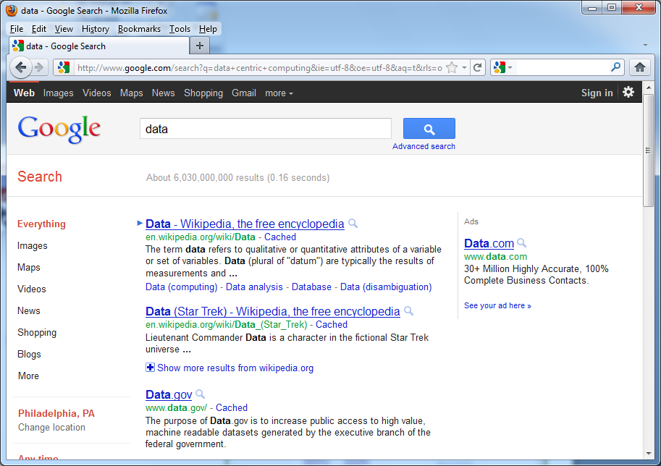
What kinds of data might we use?
We all know that Google gives good search answers because it has a lot of data…
… but what data, precisely, can it use, and how?
Let’s consider…

Slide 10
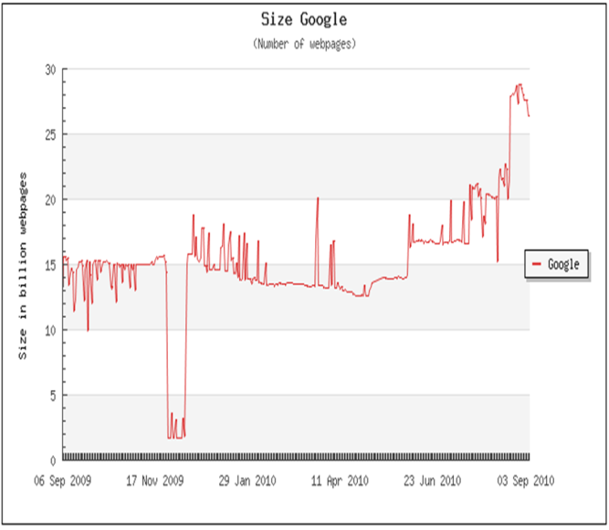
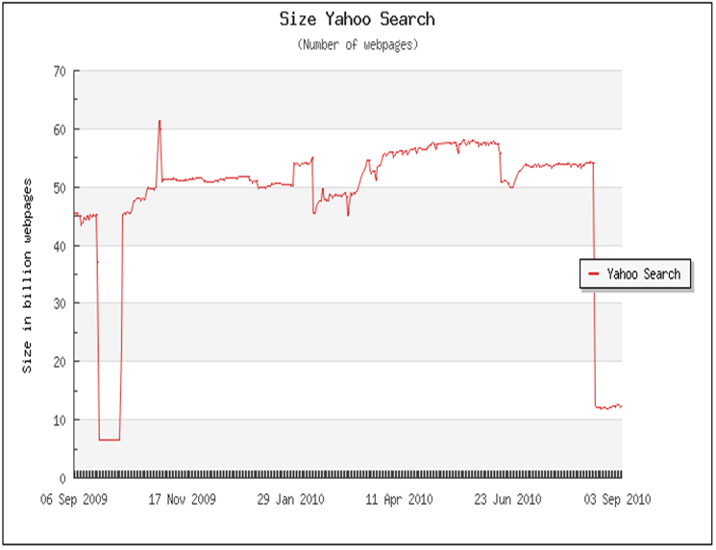
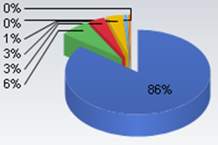
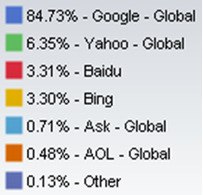
Is size everything?
27B pages
52B pages (2x Google)
Market share
Sources: worldwidewebsize.com, 9/8/2010; http://marketshare.hitslink.com/search-engine-market-share.aspx?qprid=4
Will the search engine with the most data have the best results?
Not necessarily - consider the above example from 2010
Search engines can crawl different sets of pages, and can rank them differently
What does this mean in the long term?
Notes:
TODO: are there more recent graphs?

Slide 11
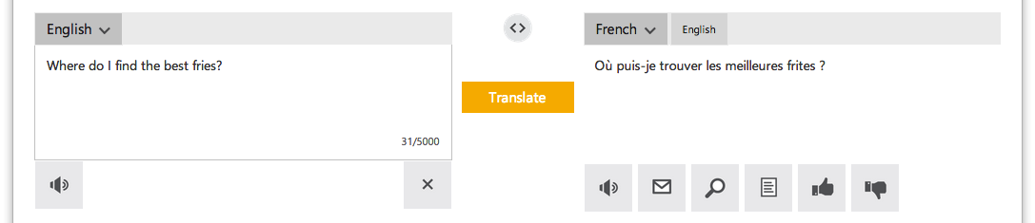
How does it work?
Google pre-crawls and analyzes millions of images – builds models
Another example: Google & Bing Translate
Model how phrases in one language map to phrases in another language, by cross-comparing many, many translated docs

Slide 12
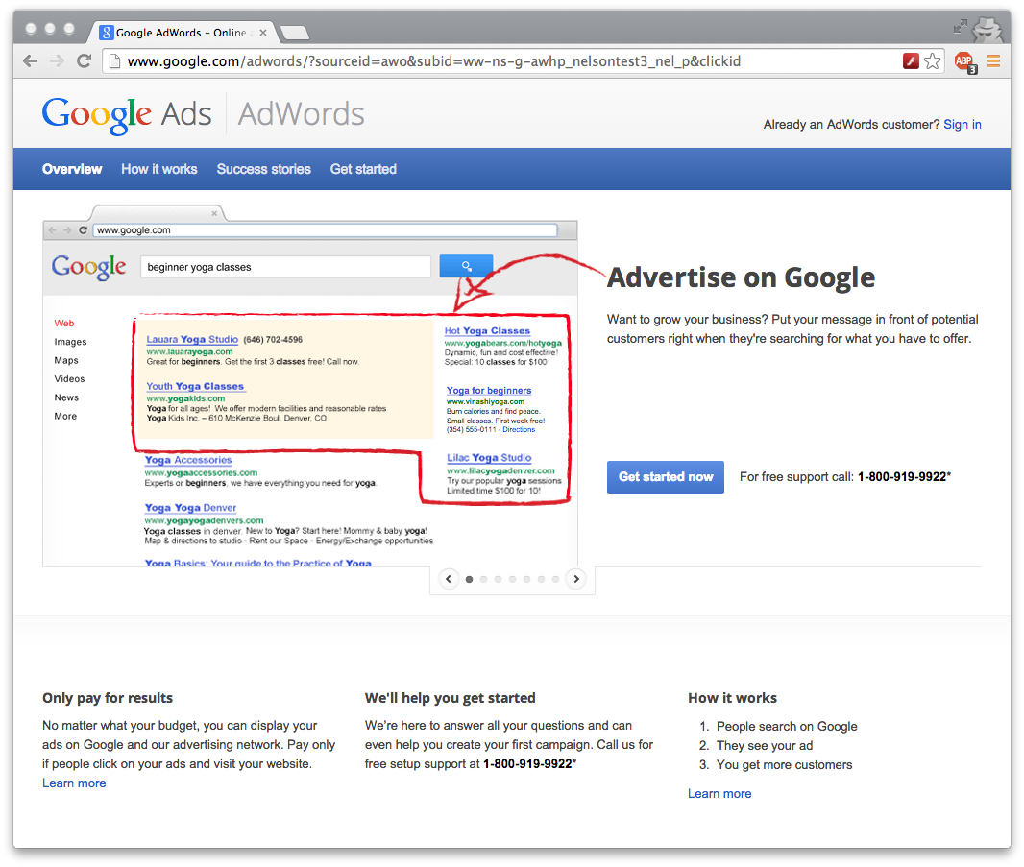
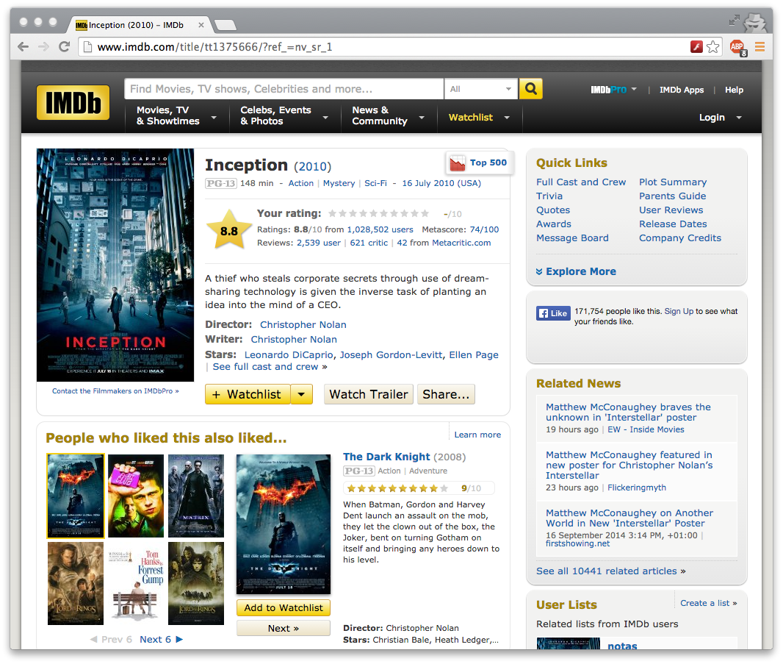
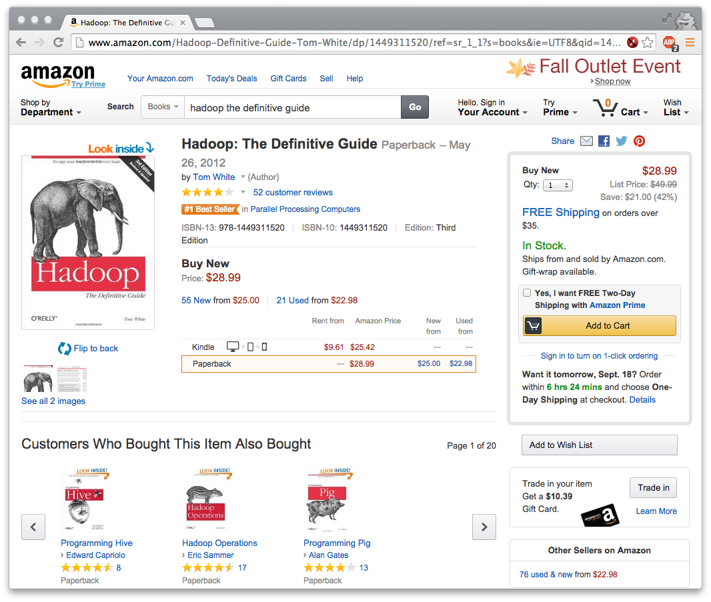
Models are valuable

Slide 13
Data-centric computing is pervasive
Today, Google and Friends aren't the only "Big Data" players
Not just Google & friends - banks, financial firms, academia, the government, companies, military, startups, ...
All need to store and analyze huge data volumes
This is being enabled with a new generation of hardware “hosting” services – “the cloud” – and programming models

Slide 14
What is INGI2145 about?
How do we build effective data-centric applications, and serve them to the entire Internet?
You’ve learned procedural programming on a single machine – we’ll look at data-centric programming across thousands of machines
We’ll understand the issues in breaking up problems, global coordination, failures, and so on
We’ll study many of the systems and algorithms used by real Internet services
How do we take advantage of “the cloud” – the vision of computing as a utility (like the power grid)?
You’ll understand what lies underneath the cloud computing hype, and how to use the cloud
You’ll build real Web projects hosted “on the cloud”

Slide 15
Towards understanding a larger trend
Internet services are increasingly integrated into the fabric of our society
Communication – Twitter, Facebook, Skype, IM, …
Media – iTunes, Spotify, Netflix, …
Markets – Amazon, eBay, stock exchanges, advertising
Utilities, commodities – smart power grids, exch. markets
Cloud computing likely to have profound implications on economical, social, ethical and legal matters
Data-centric, quantitative methods are revolutionizing advertising, sales but also science

Slide 16

Plan for today
Introduction
Course logistics
Overview
NEXT

Slide 17
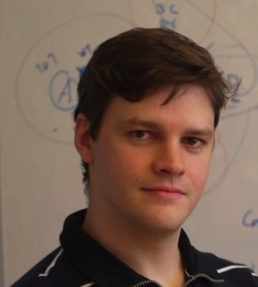

Course Staff
Marco Canini
Réaumur A-049, x7-4832
Nicolas Laurent (TA)
Réaumur A-057
Waleed Reda (TA)
Réaumur A-058

Slide 18
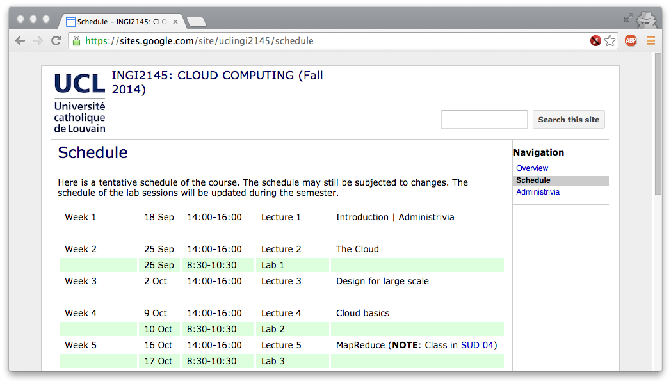
Course website
https://sites.google.com/site/uclingi2145/
All official communication is there

Slide 19
Language
This course – including all supports (lectures, exercises, exam) – is in English
Please use English
only use French if you must

Slide 20
Prerequisites
Necessary skills:
Good Java programming skills
LSINF1121 or equiv.; familiarity with Java
If you don't have a lot of programming experience yet, you should be willing to invest the necessary time
Some familiarity with Linux command line
Background in computer networks (LINGI1341) and OS (LSINF1252)
A willingness to “push the envelope”
Example: We'll be using Node.js + Bootstrap this year, so you'll need to learn a bit of CSS and JavaScript

Slide 21

Course discussion group
We will be using for discussions related to this course
Examples: Questions about homework assignments
The TAs and I will read the posts and respond to questions
Piazza will also be used for
Announcements, e.g., cancelled classes (if necessary)
Supplemental materials, e.g., links to relevant papers
Corrections/clarifications, e.g., bugs in homework handouts
Please check the group frequently!
Please sign up at
https://piazza.com/uclouvain.be/fall2014/ingi2145
TODO
Notes:
TODO: check link

Slide 22
Lectures
Regularly Thursdays 14:00 to 16:00, BARB 00
Could exceptionally be on Fridays 8:30 to 10:30, BARB 21
Check online schedule often
Be on time!
No lecture notes but reference books
Participation to class counts towards grade
Will keep a presence sheet but just presence is not sufficient
Engage in discussion, make insightful questions or comments
May organize in-class quizzes on material covered in prior classes

Slide 23
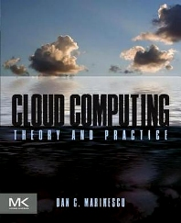
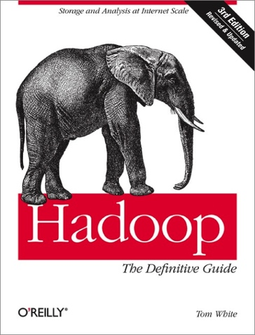
Readings
This field is too recent, and too fast-moving to truly have a good textbook yet
Two reference books:
"Cloud Computing: Theory and Practice" by Dan C. Marinescu (Morgan Kaufmann)
"Hadoop: The Definitive Guide, 3rd edition" by Tom White (O’Reilly)
Supplementary handouts and Web references
Refer to course website
Handouts, slides, example code, ..., will be published there
http://secure-ecsd.elsevier.com/covers/80/Tango2/large/9780124046276.jpg
http://shop.oreilly.com/product/0636920021773.do

Slide 24
Additional readings (optional)
The Datacenter as a Computer: An Introduction to the Design of Warehouse-Scale Machines, Second edition
Luiz André Barroso, Jimmy Clidaras, Urs Hölzle
http://www.morganclaypool.com/doi/abs/10.2200/S00516ED2V01Y201306CAC024
Above the Clouds: A Berkeley View of Cloud Computing
Michael Armbrust, Armando Fox, Rean Griffith, Anthony D. Joseph, Randy Katz, Andy Konwinski, Gunho Lee, David Patterson, Ariel Rabkin, Ion Stoica, and Matei Zaharia
http://www.eecs.berkeley.edu/Pubs/TechRpts/2009/EECS-2009-28.pdf

Slide 25
Lab sessions
We will organize ~6-7 lab sessions
Complement the lectures with more practical information and hands-on exercises
A sketch solution of the exercises will be presented during the session
Labs on Fridays 8:30 to 10:30, BARB 21
Conflicts? Propose a slot that works for all and we will try to move lab sessions
Attendance is optional but highly encouraged
Notes:
TODO: check number of labs

Slide 26
Homework assignments
We will organize 2-3 homework assignments
They are all mandatory
No extensions granted
Automatic lateness penalty applies: 10% deducted on the assignment grade for each day late or fraction thereof
If an assignment is 1 minute late, it is one day late
Start to work on them early
Do not wait until the last day before homework is due
Deploy and run code on Amazon EC2
But credit is limited. Don’t blow it up!
We will offer a standardized development system that is based on a virtual machine

Slide 27
The INGI2145 Virtual Machine
We will provide a virtual machine with the necessary software
Linux, Hadoop, Amazon CLI, …
Use with VMware Player, VirtualBox, etc.
Safe to experiment with
Standardized environment makes it easier to support
We will not support custom environments
First lab session
Demonstrate how to provision the virtual machine through Vagrant and Puppet
Getting setup with Amazon Web Services (AWS)

Slide 28
Grading
Final exam: 60%
Homework: 30%
In-class participation: 10%
Note: Homework grade and participation grade carry to the second examination session (September) as they cannot be repeated
Grading policy is the same for first and second examination session

Slide 29
Policies: Collaboration
All assignments must be done individually
All the code you submit has to be your own
Only exception: Code we have provided or explicitly authorized
UCL's regulations applies
No cheating, plagiarism, fabrication, multiple submissions, gaining an unfair advantage, or facilitating (!) academic dishonesty
It's not worth it!! Penalties can be severe: http://www.uclouvain.be/enseignement-reglements.html
Zero tolerance policy to ensure fairness
We will use various tools to actively look for cheating

Slide 30

Policies: Collaboration
Yes
No
Can we work on assignments together?
Can I discuss the assignment with others (in general terms)?
Can I use code I copied from the web?
Can I ask questions about the assignments on Piazza?
I just happened to leave my password on my table, and XYZ just happened to find it. Will I be penalized for this?
Yes
No
Yes
No
Yes
No
Yes
No

Slide 31
Expected 'payoff'
You will acquire a set of skills that is in very high demand right now
At Google, Facebook, and at many other places
You will gain interesting insights
You will have a good basis for other courses

Slide 32
A disclaimer…
This is a “bleeding edge” course!
UCL is one of a handful of places offering these topics
The subject of this course is still evolving: no established curriculum, no classical textbooks yet
Some of the material in the course will result in hair loss
Debugging distributed code is hard!
We will be using some immature technology
We will do the best we can to smooth over the bugs
I hope it will be a fun course, though…
… and an interesting one!

Slide 33
Plan for today
Introduction
Course logistics
Overview
NEXT

Slide 34


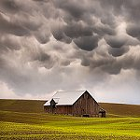


Cloud basics
What is 'the cloud'?
Types of clouds; xAAS; utility computing
What kinds of services does it provide?
AWS, EC2, EBS, S3, SimpleDB, key-value stores, ...
Amazon has donated free AWS usage credits for your homeworks
Case studies of cloud-based services

Slide 35
Technical challenges
CPU #6
CPU #5
T2
T4
T5
CPU #4
T1
T3
T6
CPU #3
Time
CPU #2
CPU #1
T1
T2
T3
T6
T4
T5
Time
Same start state
Time
What are key challenges in cloud computing?
Scale, concurrency, consistency, security, availability, ...
Speed of light (!), unreliable machines, ...
What can you do about these challenges?
Concurrency control, weak consistency, locking, replication, ...
Special types of extremely scalable algorithms

Slide 36
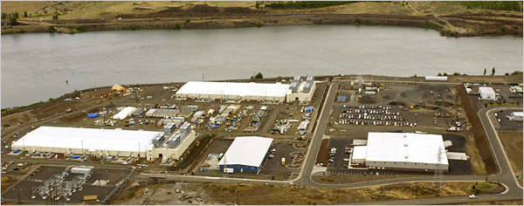
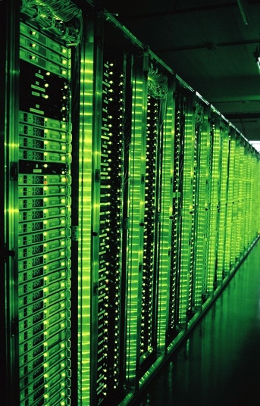

Programming the cloud
http://www.nytimes.com/2006/06/14/technology/14search.html
Source: 1&1
How to program a building-sized computer?
MapReduce programming model; Hadoop
Beyond MapReduce: LINQ, Hive, PigLatin, XQuery, ...
How to store/process petabytes of data?
Cloud file systems; HDFS; replication

Slide 37
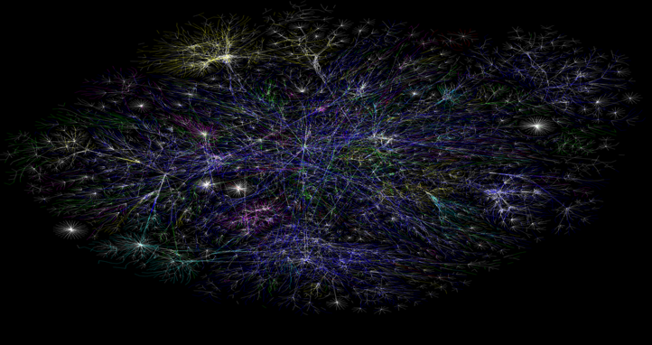
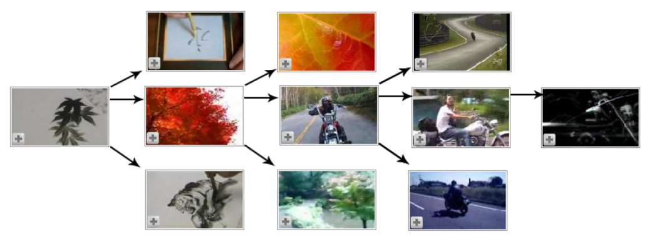
Working with large data sets
Source: Baluja et al., WWW 2008
http://www.opte.org/maps/
Useful algorithms:
How does YouTube recommend movies to you?
How does Google find the relevant pages for your search?
How does Goggle recognize images?
How can you (automatically) tell which emails are spam?
How does Facebook find out who your friends might be?

Slide 38
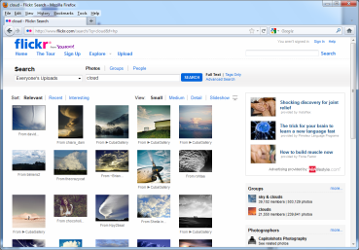


Interacting with the cloud
Belnet
Servlet
Servlet
HTTP
Google
UCL
Server in California
Client
Servlet container
Level 3
Belgacom
How do users interact with the cloud?
Internet and web protocols: TCP, DNS, HTTP...
How to build a web server; Java servlets
Dynamic content: Ajax, Node.js; "Web 2.0”
How are cloud services interconnected?

Slide 39
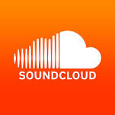
Industry perspective
Cloud Computing for Behavioural Tracking by Sean Braithwaite (SoundCloud)
What, Why, How
Architectures: validation; transmission; storage…
Case studies at SoundCloud and more

Slide 40
Advanced topics (time permitting)
Advanced cloud services
Cloud resource scheduling and allocation
Cloud networks
Data center networking
Capacity sharing
Cloud research at UCL
Adaptive distributed systems

Slide 41
Any questions?

Slide 42
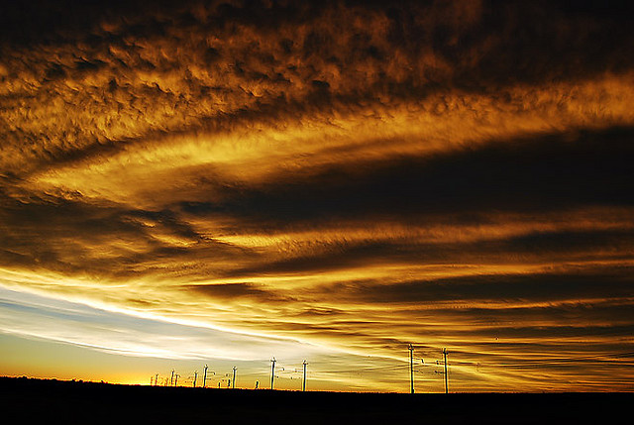
Stay tuned
http://www.flickr.com/photos/10909957@N03/3135455311/
Next time you will learn about: Kinds of clouds; utility computing

